Slide 1
Project MLOps
Mathias Goris & Arthur Hofman

Slide 2

Project Context
Smurf Guest Profit Predictor
training set = behavior of 5000 Smurf hotel guests

Slide 3
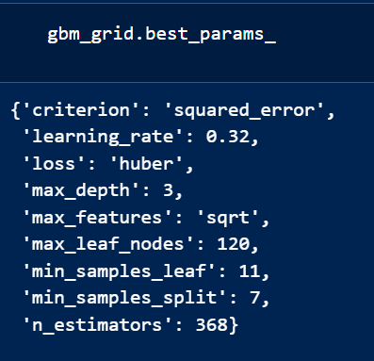
Machine learning model
GradientBoostingRegressor
Beste performance in vorig project
Gebruikt clean dataset

Slide 4
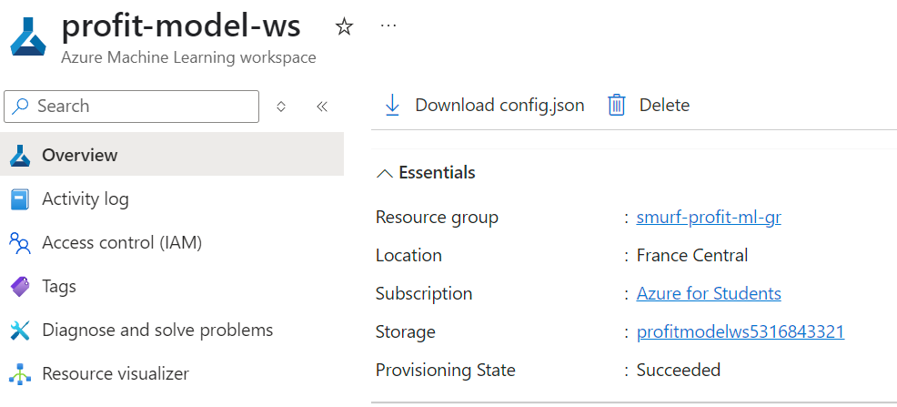
Azure ML Setup (Task 1)
Resource group: smurf-profit-ml-gr
Workspace: profit-model-ws
Computes: cc-profit-train, ci-profit-dev
Registered cleaned dataset
App Registration voor GitHub: github-ml-pipeline

Slide 5
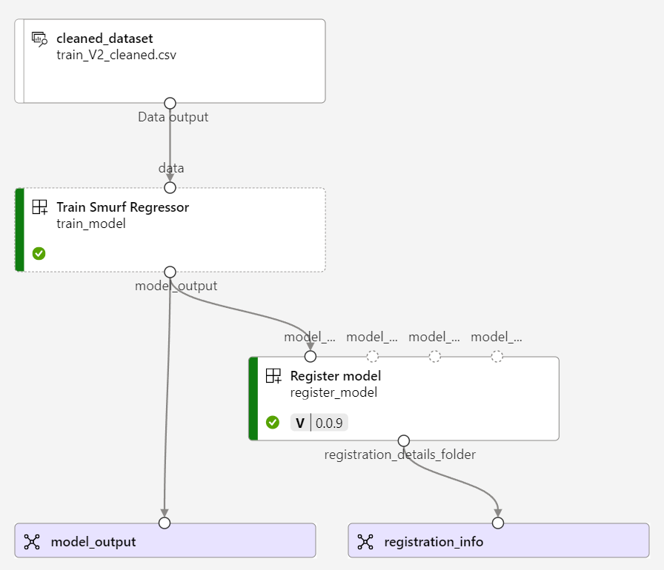
Azure ML Setup (Task 1)
smurf-train-env.yaml: environment definition for dependencies
az ml environment create --file profit-predictor/smurf-train-env.yaml
pipeline.yaml: defines the whole pipeline
train_regressor.yaml: describes the training component
train.py: actual Python script that trains the model
az ml job create --file pipeline.yaml

Slide 6
FastAPI & Kubernetes (Task 2)

Slide 7
Automation & DevOps (Task 3)

Slide 8
Challenges & Learnings

Slide 9
Demo & Result

Slide 10
Einde
Zijn er nog vragen?

